Slide 1
Circular Queue

Slide 2
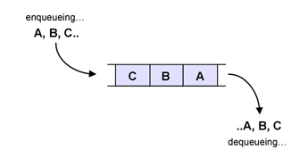
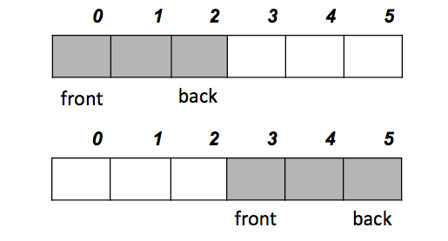
Queue in Action
Active part of the queue keeps on moving and hit the array limit at some stage ☹

Slide 3
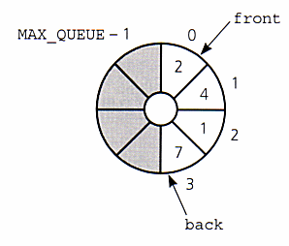
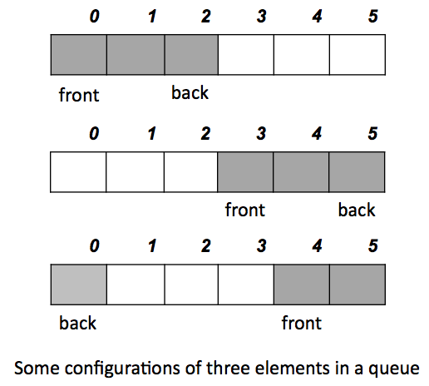
Circular Array Implementation

Slide 4
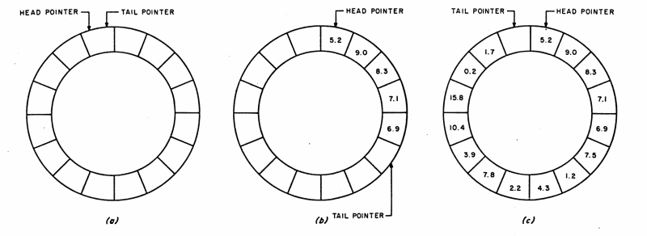
Circular Array Implementation

Slide 5
Applications
Print queue
Buffers for communication between two entities
Network cards need a packet buffer
Secondary storage write through buffers

